Slide 1
Autonomous Cyber-Physical Systems Timed Models
Fall 202. CSCI 513.
Instructor: Jyo Deshmukh
Acknowledgment: Some of the material in these slides is based on the lecture slides for CIS 540: Principles of Embedded Computation taught by Rajeev Alur at the University of Pennsylvania. http://www.seas.upenn.edu/~cis540/

Slide 2
Dynamical Systems
Most natural model for describing most physical systems
Continuous/discrete systems that continuously evolve over time
Convenient to model such systems with differential equations
Typically consist of physical quantities modeled as state variables
Pressure, Temperature, Velocity, Acceleration, Current, Voltage, etc.
Could include algebraic relations between state variables
Execution semantics similar to synchronous models, but with continuous-time semantics instead of discrete-time

Slide 3
Continuous-time Component (Algebraic)
real x
real error
error = (x – x_{ref})
real x_{ref}
Input variables: x and x_{ref} of type real, Output variable: error of type real
No state variables
Signals: Assignments of values to variables as a function of time
At each time t, error(t) = x(t) – x_{ref}(t)
Input/Output relation expressed algebraically instead of as an assignment

Slide 4
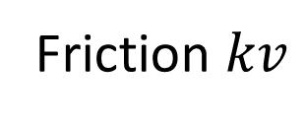
Model of a simple car
Force $F$
Position $x$
Velocity $v$
Friction $kv$
Newton’s law of motion: $F −kv=m\frac{d^{2}x}{dt^{2}};v=\frac{dx}{dt}$

Slide 5
Continuous-time component (differential)
real $x_{low}≤x≤x_{high}$
$$x$$
Rate of change of each state variable and output variables defined using expressions over inputs and states
$$F$$
real $v_{low}≤v≤v_{high}$
$$v$$
$$m\frac{d^{2}x}{dt^{2}}= F −kv$$
$v=\frac{dx}{dt}$
$$\dot{x}=v$$
$$\dot{v}=\frac{F−kv}{m}$$
Expressions, not assignments!

Slide 6
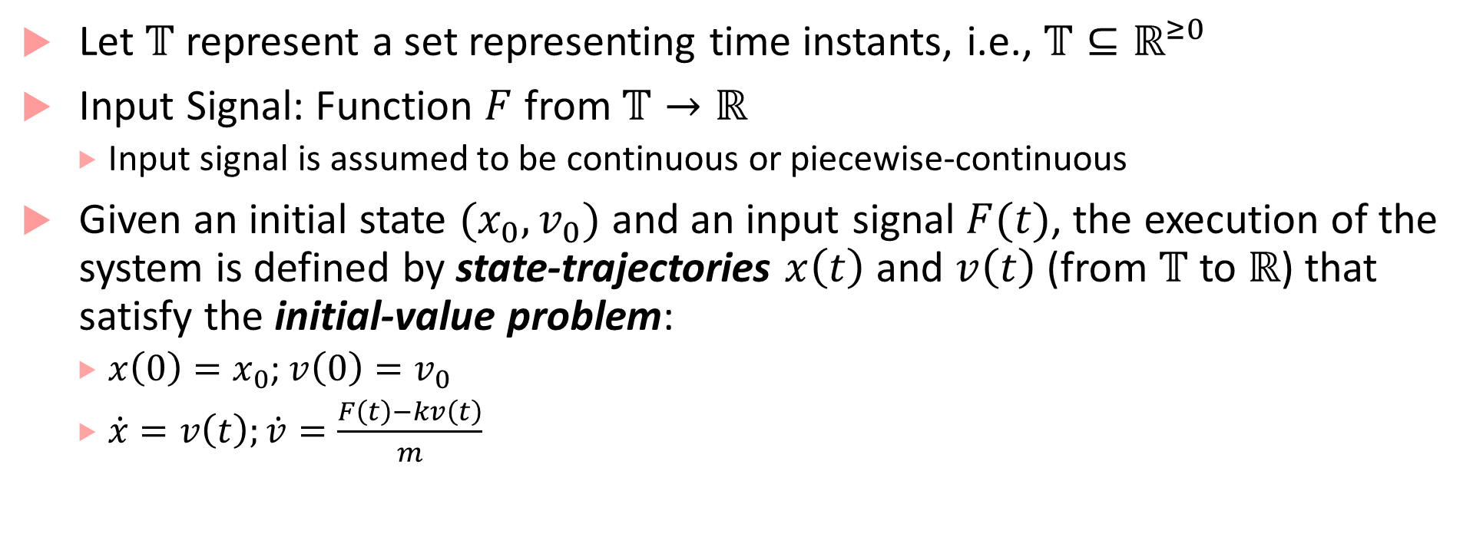
Executions of Car
Let $𝕋$ represent a set representing time instants, i.e., $𝕋⊆ℝ^{≥0}$
Input Signal: Function $F$ from $𝕋→ℝ$
Input signal is assumed to be continuous or piecewise-continuous
Given an initial state $(x_{0},v_{0})$ and an input signal $F(t)$, the execution of the system is defined by state-trajectories $x\left(t\right)$ and $v\left(t\right)$ (from $𝕋$ to $ℝ$) that satisfy the initial-value problem:
$x\left(0\right)=x_{0}$; $v\left(0\right)=v_{0}$
$\dot{x}=v\left(t\right);\dot{v}=\frac{F\left(t\right)−kv\left(t\right)}{m}$

Slide 7
Sample Execution of Car
Suppose $∀t:F\left(t\right)=0, x_{0}=5 m, v_{0}=20 m/s$. Then, we need to solve:
$x\left(0\right)=5;v\left(0\right)=20$
$\dot{x}=v$;$\dot{v}=−\frac{kv}{m}$
Solution to above differential equation (solve for $v$ first, then $x$):
$v\left(t\right)=v_{0}e^{−\frac{kt}{m}}$; $x\left(t\right)=\frac{mv_{0}}{k}\left(1−e^{−\frac{kt}{m}}\right)$
Note, as $t→∞$, $v\left(t\right)→0$, and $x\left(t\right)→\frac{mv_{0}}{k}$
$$m=1000kg$$
$$k=50Ns/m$$

Slide 8
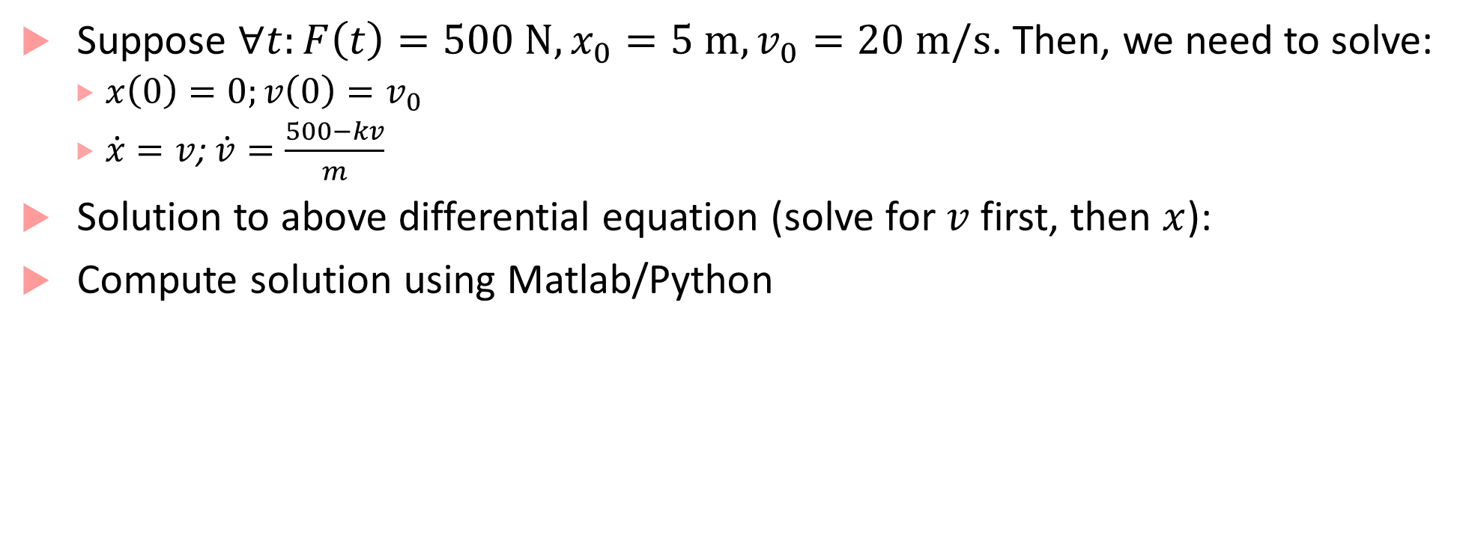
Sample Execution of Car with constant force
Suppose $∀t:F\left(t\right)=500 N, x_{0}=5 m,v_{0}=20 m/s$. Then, we need to solve:
$x\left(0\right)=0;v\left(0\right)=v_{0}$
$\dot{x}=v$;$\dot{v}=\frac{500−kv}{m}$
Solution to above differential equation (solve for $v$ first, then $x$):
Compute solution using Matlab/Python
$$m=1000kg$$
$$k=50Ns/m$$

Slide 9
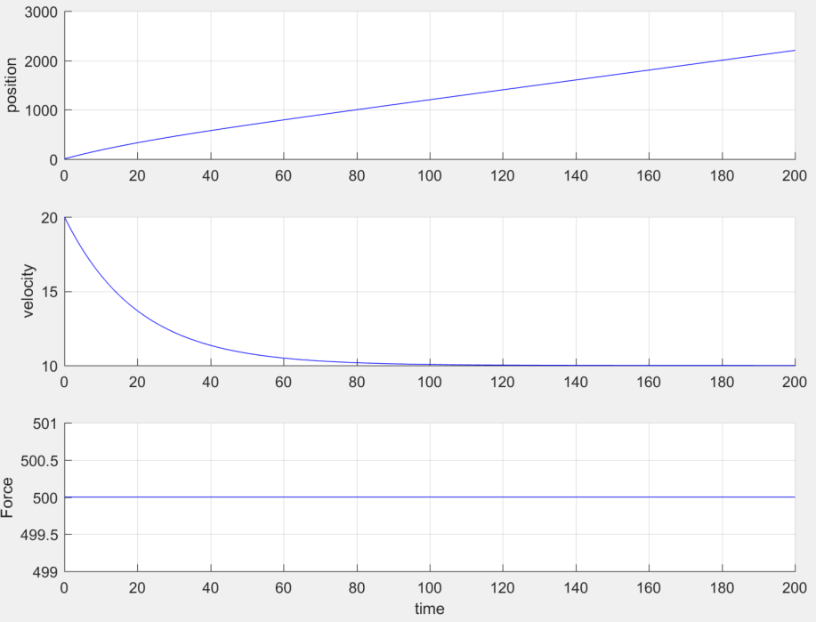
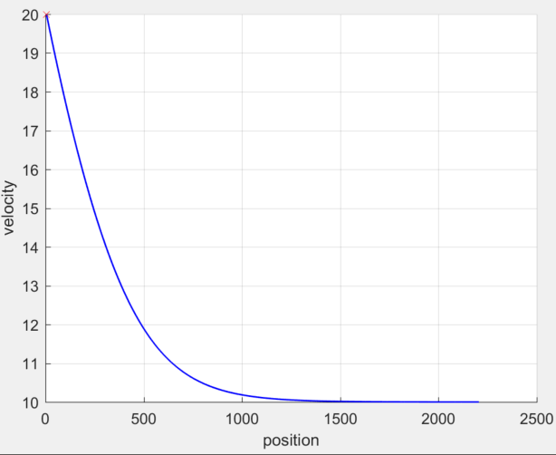
Plots
Phase Plot
Input/Output Signals

Slide 11



Timed ESMs
Like asynchronous ESMs, have input, output channels, state variables
Special type of state variable called “clock”
Clock variables evolve continuously in time
ESM can “stay” in a mode with clock increasing monotonically from the start value
(press==1)? $∧$ (c$≥$1)
clock c:=0
off
dim
(press==1)? $∧$ (c$≤$1)
bright
(press==1)?$→$
c:=0
(press==1)?

Slide 12

Transitions of a timed ESM
(press==1)? $∧$ (c$≥$1)
Mode switch: discrete action
machine moves from one mode to another
guard on the transition must be true for mode switch to occur
update specified by the transition will update/reset clock variables
clock c:=0
off
dim
(press==1)? $∧$ (c$≤$1)
bright
(press==1)?$→$
c:=0
(press==1)?
(press==1)?
(off,0.5)
(dim,0)

Slide 13
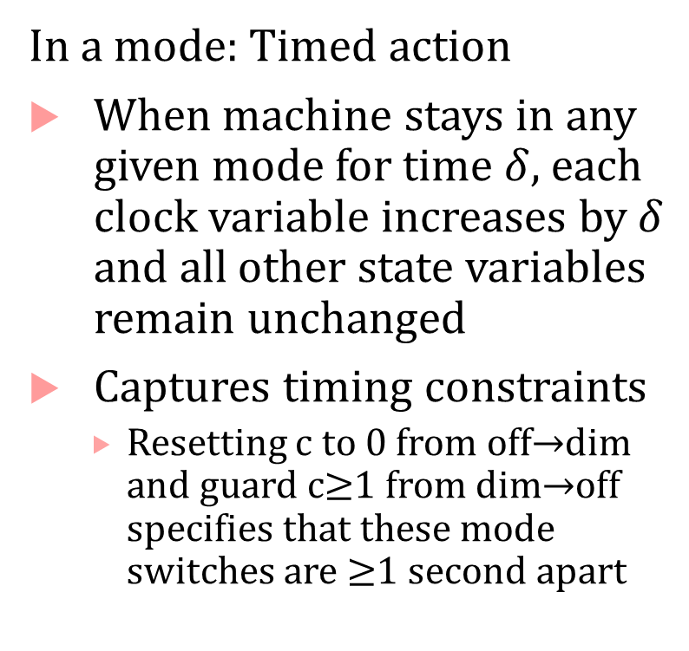
Transitions of a timed ESM
In a mode: Timed action
When machine stays in any given mode for time $δ,$each clock variable increases by $δ$ and all other state variables remain unchanged
Captures timing constraints
Resetting c to 0 from off$→$dim and guard c$≥$1 from dim$→$off specifies that these mode switches are $≥$1 second apart
(press==1)? $∧$ (c$≥$1)
clock c:=0
off
dim
(press==1)? $∧$ (c$≤$1)
bright
(press==1)?$→$
c:=0
(press==1)?

Slide 14
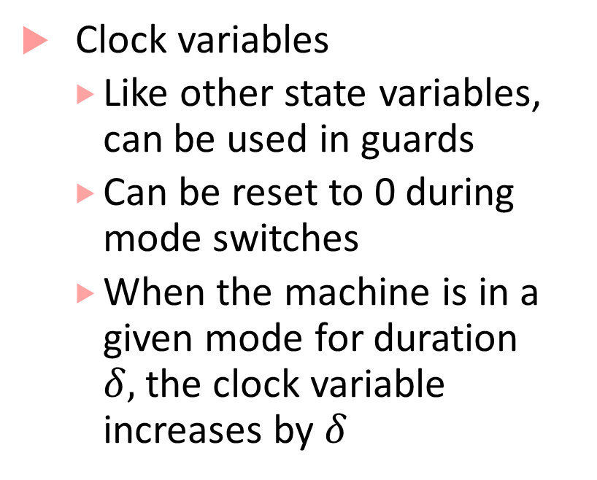


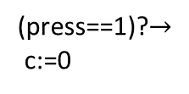
Timed Processes: explicit clock variables
(press==1)? $∧$ (c$≥$1)
Clock variables
Like other state variables, can be used in guards
Can be reset to 0 during mode switches
When the machine is in a given mode for duration $δ,$the clock variable increases by $δ$
clock c:=0
off
dim
(press==1)? $∧$ (c$≤$1)
bright
(press==1)?$→$
c:=0
(press==1)?

Slide 15


Timed Process Execution
(press==1)? $∧$ (c$≥$1)
Machine execution is through alternating timed transitions and mode switches
clock c:=0
off
dim
(press==1)? $∧$ (c$≤$1)
bright
(press==1)?$→$
c:=0
(press==1)?
(press==1)?
(press==1)?
(off,0)
(off,0.5)
(dim,0)
(dim,0.8)
(bright,0.8)

Slide 16

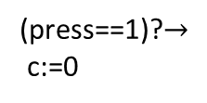

Timed Process Execution
(press==1)? $∧$ (c$≥$1)
Machine execution is through alternating timed transitions and mode switches
clock c:=0
off
dim
(press==1)? $∧$ (c$≤$1)
bright
(press==1)?$→$
c:=0
(press==1)?
(press==1)?
(off,0)
(off,0.5)
(dim,0)
(press==1)?
(dim,3.8)
(off,3.8)

Slide 17

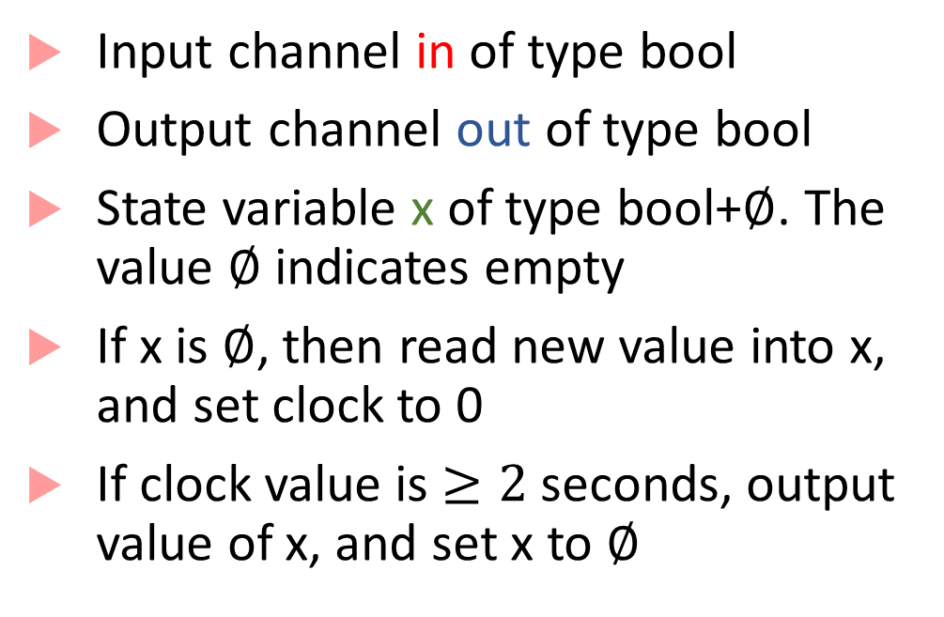

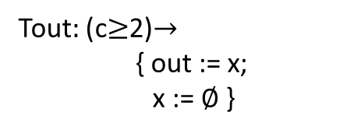
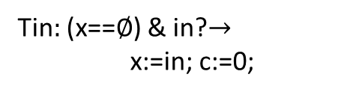
Timed Buffer
Input channel in of type bool
Output channel out of type bool
State variable x of type bool+$∅$. The value $∅$ indicates empty
If x is $∅$, then read new value into x, and set clock to 0
If clock value is $≥2$ seconds, output value of x, and set x to $∅$
bool in
${\text{bool}}_{∅}$ x:= $∅$, clock c:=0
bool
out
Tin$:$ (x==$∅$) & in?$→$
x:=in; c:=0;
Tout$:$ (c$≥$2)$→$
{ out := x;
x := $∅$ }
T_{infull}$:$ in? $→$

Slide 18

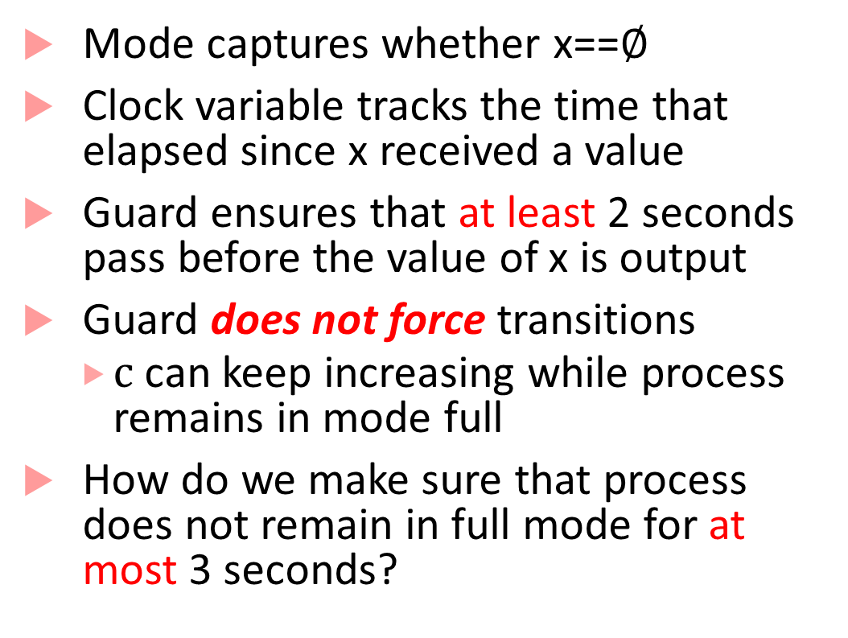

Timed State Machine representation
Mode captures whether x==$∅$
Clock variable tracks the time that elapsed since x received a value
Guard ensures that at least 2 seconds pass before the value of x is output
Guard does not force transitions
$c$ can keep increasing while process remains in mode full
How do we make sure that process does not remain in full mode for at most 3 seconds?
c$≥2$ $→$ out:=x, x≔$∅$
in?
c:=0
empty
full
in?$→$ x:=in, c:=0

Slide 19
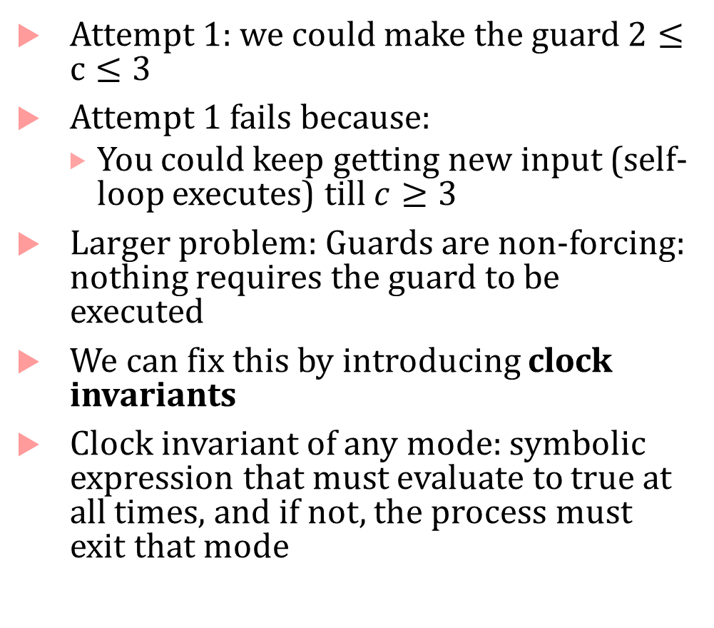

Clock invariants
Attempt 1: we could make the guard $2≤c≤3$
Attempt 1 fails because:
You could keep getting new input (self-loop executes) till $c≥3$
Larger problem: Guards are non-forcing: nothing requires the guard to be executed
We can fix this by introducing clock invariants
Clock invariant of any mode: symbolic expression that must evaluate to true at all times, and if not, the process must exit that mode
c$≥2$ $→$ out:=x, x≔$∅$
in?
c:=0
empty
full
in?$→$ x:=in, c:=0

Slide 20
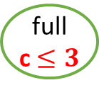
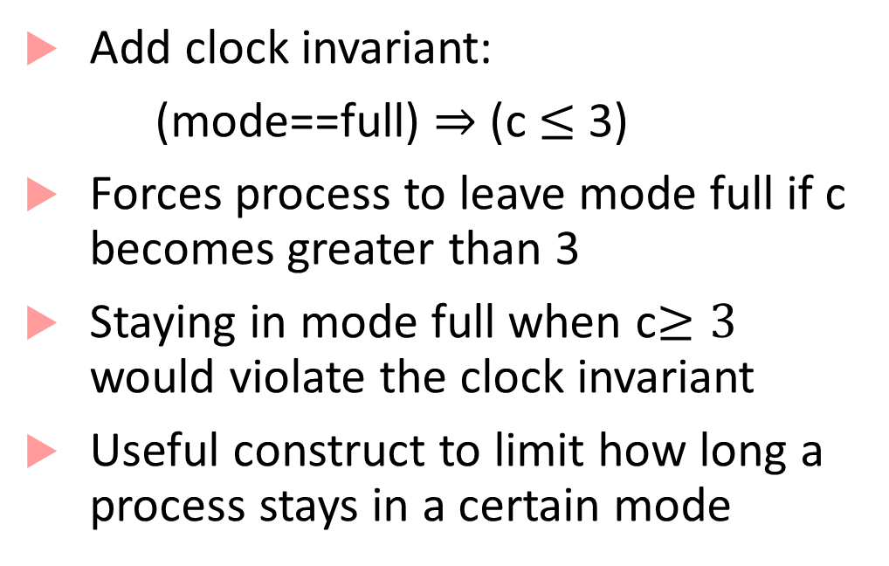
Clock invariants
Add clock invariant:
(mode==full) $⇒$ (c $≤$ 3)
Forces process to leave mode full if c becomes greater than 3
Staying in mode full when c$≥3$ would violate the clock invariant
Useful construct to limit how long a process stays in a certain mode
c$≥2$ $→$ out:=x, x≔$∅$
in?
c:=0
empty
full
c $≤3$
in?$→$ x:=in, c:=0

Slide 21

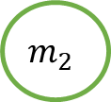
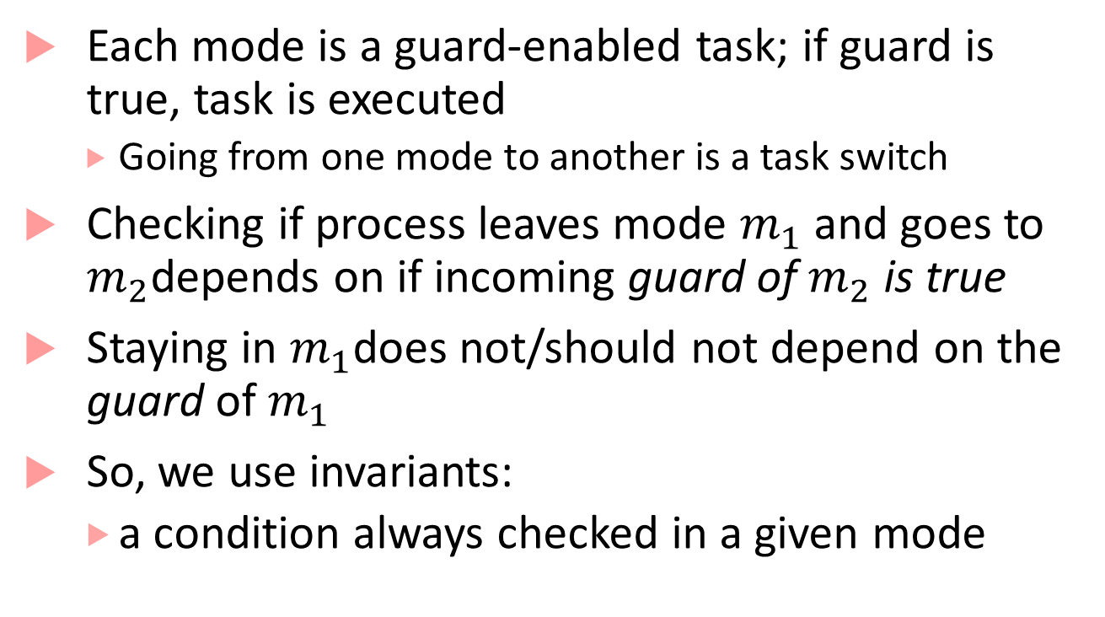


Why model using invariants and guards?
Each mode is a guard-enabled task; if guard is true, task is executed
Going from one mode to another is a task switch
Checking if process leaves mode $m_{1}$ and goes to $m_{2}$depends on if incoming guard of $m_{2}$ is true
Staying in $m_{1}$does not/should not depend on the guard of$m_{1}$
So, we use invariants:
a condition always checked in a given mode
$$m_{1}$$
$$g_{2}$$
$$g_{1}$$
$$m_{2}$$

Slide 22
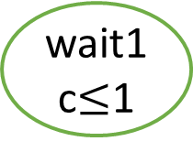
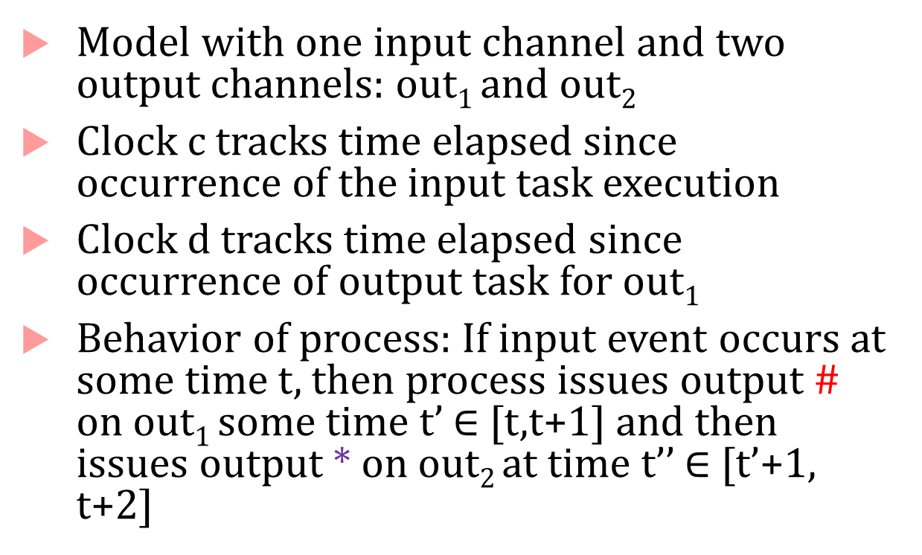
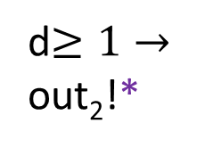
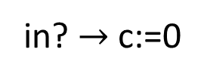
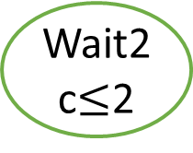
Example with two clocks
clock c,d:=0
Model with one input channel and two output channels: out₁ and out₂
Clock c tracks time elapsed since occurrence of the input task execution
Clock d tracks time elapsed since occurrence of output task for out₁
Behavior of process: If input event occurs at some time t, then process issues output # on out₁ some time t’ $∈$ [t,t+1] and then issues output * on out₂ at time t’’ $∈$ [t’+1, t+2]
idle
in? $→$ c:=0
wait1
c$≤$1
out₁!#;d:=0
d$≥1→$
out₂!*
Wait2
c$≤$2

Slide 23
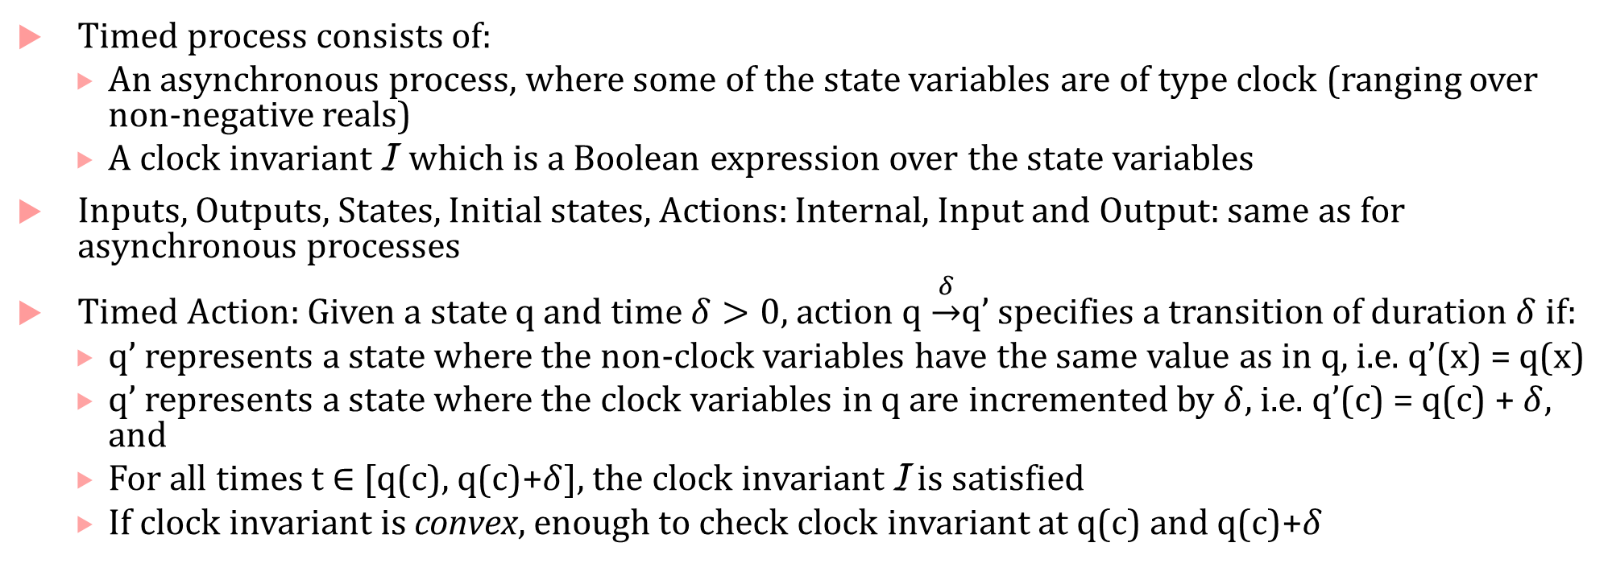
Formal recap of a timed process
Timed process consists of:
An asynchronous process, where some of the state variables are of type clock (ranging over non-negative reals)
A clock invariant I which is a Boolean expression over the state variables
Inputs, Outputs, States, Initial states, Actions: Internal, Input and Output: same as for asynchronous processes
Timed Action: Given a state q and time $δ>0$, action q $\underset{→}{δ}$q’ specifies a transition of duration $δ$ if:
q’ represents a state where the non-clock variables have the same value as in q, i.e. q’(x) = q(x)
q’ represents a state where the clock variables in q are incremented by $δ$, i.e. q’(c) = q(c) + $δ,$ and
For all times t $∈$ [q(c), q(c)+$δ$], the clock invariant I is satisfied
If clock invariant is convex, enough to check clock invariant at q(c) and q(c)+$δ$

Slide 24
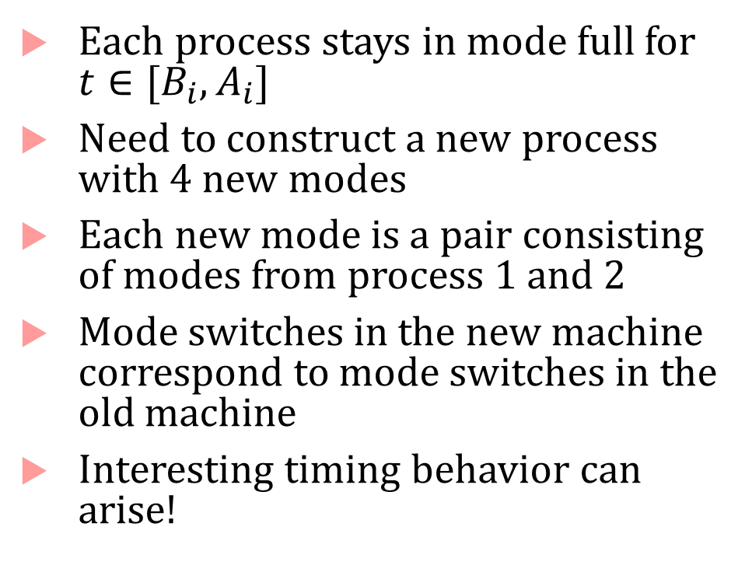


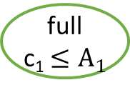

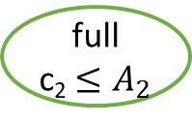

Composing Timed Processes
Each process stays in mode full for $t∈[B_{i}, A_{i}]$
Need to construct a new process with 4 new modes
Each new mode is a pair consisting of modes from process 1 and 2
Mode switches in the new machine correspond to mode switches in the old machine
Interesting timing behavior can arise!
c₁$≥$B₁ $→$ out₁:=x₁, x₁≔$∅$
c₁:=0
empty
full
c₁ $≤A_{1}$
in?$→$ x₁:=in, c₁:=0
c₂$≥$B₂ $→$ out₂:=x₂, x₂≔$∅$
c₂:=0
empty
full
c₂ $≤A_{2}$
in?$→$ x₂:=in, c₂:=0

Slide 25
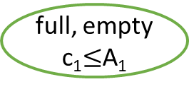
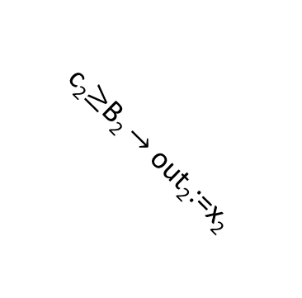


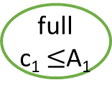
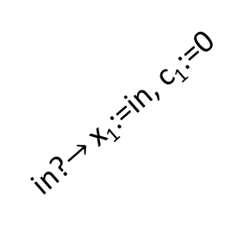

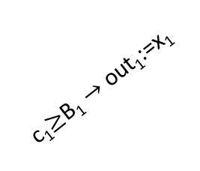
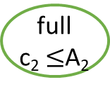

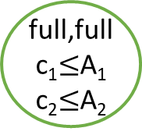
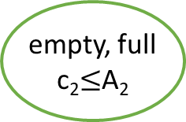

Composing Timed Processes
c₁$≥$B₁ $→$ out₁:=x₁
in?
full, empty
c₁$≤$A₁
c₁:=0
empty
full
c₁ $≤$A₁
c₂$≥$B₂ $→$ out₂:=x₂
c₁$≥$B₁ $→$ out₁:=x₁
in?$→$ x₁:=in, c₁:=0,
x₂:=in, c₂:=0
full,full
c₁$≤$A₁
c₂$≤$A₂
in?$→$ x₁:=in, c₁:=0
empty,
empty
in?
c₂$≥$B₂ $→$ out₂:=x₂
in?
c₁$≥$B₁ $→$ out₁:=x₁
c₂:=0
empty
full
c₂ $≤$A₂
c₂$≥$B₂ $→$ out₂:=x₂
in?$→$ x₁:=in, c₁:=0
empty, full
c₂$≤$A₂
in?$→$ x₂:=in, c₂:=0
in?

Slide 26
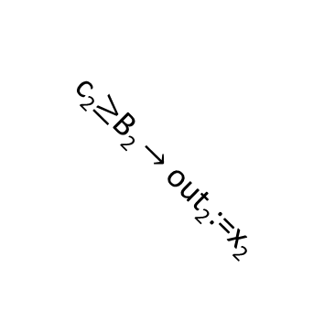
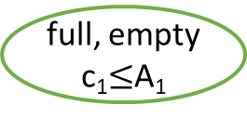

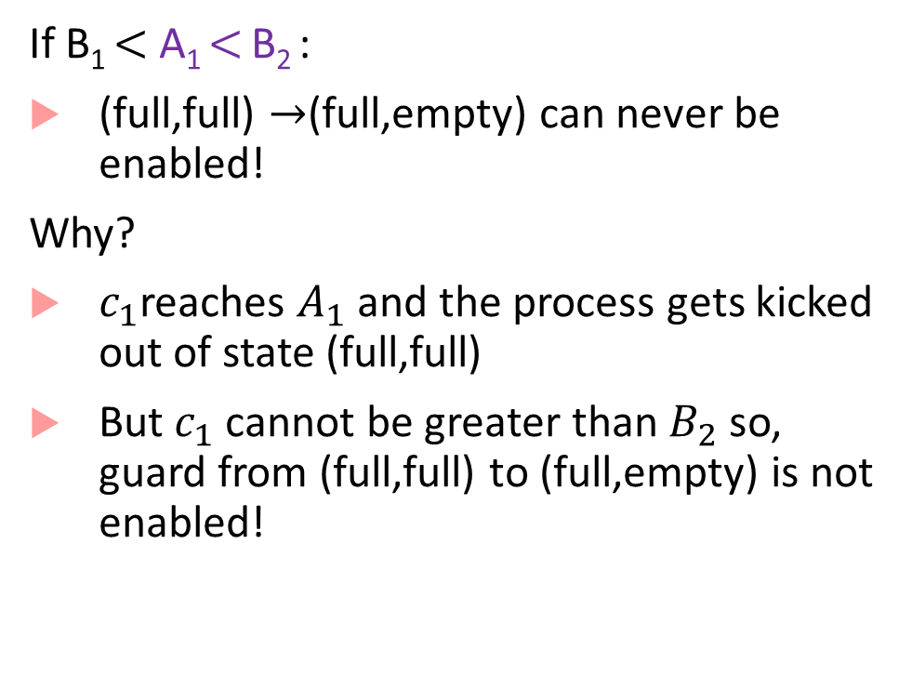
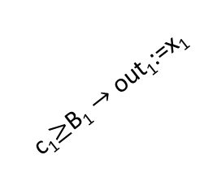
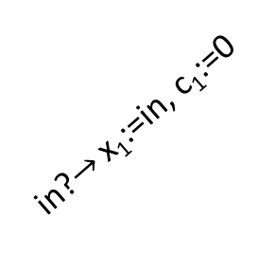
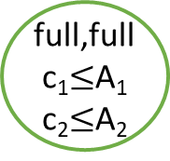


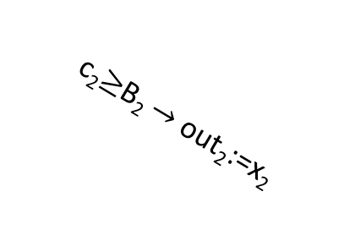
Semi-synchrony
If B₁ $<$ A₁ $<$ B₂ :
(full,full) $→$(full,empty) can never be enabled!
Why?
$c_{1}$reaches $A_{1}$ and the process gets kicked out of state (full,full)
But $c_{1}$ cannot be greater than $B_{2}$ so, guard from (full,full) to (full,empty) is not enabled!
full, empty
c₁$≤$A₁
c₂$≥$B₂ $→$ out₂:=x₂
c₁$≥$B₁ $→$ out₁:=x₁
in?$→$ x₁:=in, c₁:=0,
x₂:=in, c₂:=0
full,full
c₁$≤$A₁
c₂$≤$A₂
empty,
empty
in?
c₁$≥$B₁ $→$ out₁:=x₁
c₂$≥$B₂ $→$ out₂:=x₂
in?$→$ x₁:=in, c₁:=0
empty, full
c₂$≤$A₂
in?

Slide 27
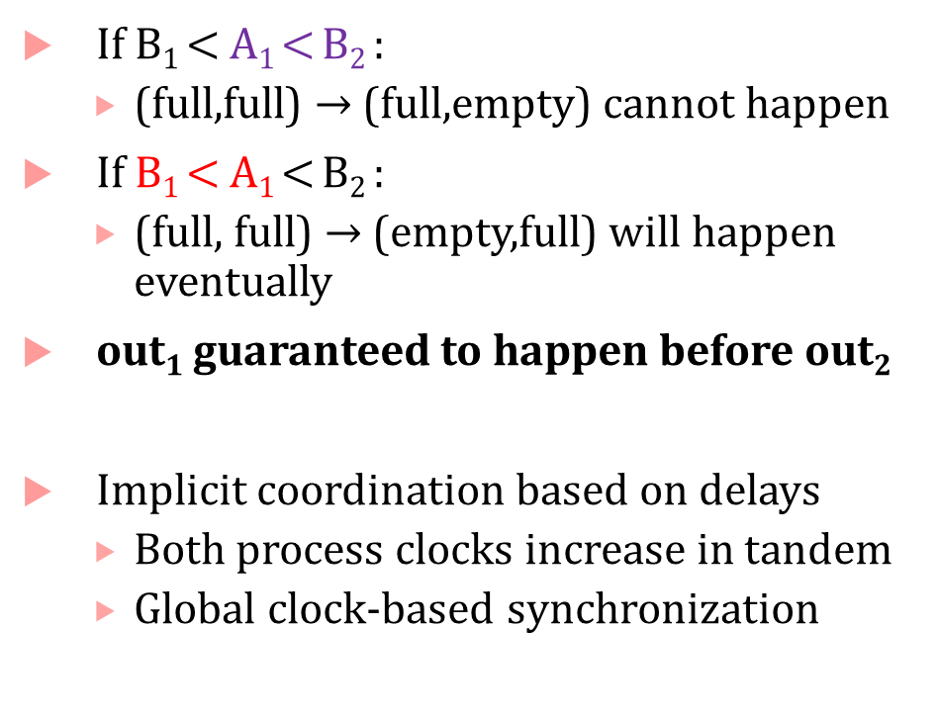
Semi-synchrony
If B₁ $<$ A₁ $<$ B₂ :
(full,full) $→$ (full,empty) cannot happen
If B₁ $<$ A₁ $<$ B₂ :
(full, full) $→$ (empty,full) will happen eventually
out₁ guaranteed to happen before out₂
Implicit coordination based on delays
Both process clocks increase in tandem
Global clock-based synchronization
full, empty
c₁$≤$A₁
c₂$≥$B₂ $→$ out₂:=x₂
c₁$≥$B₁ $→$ out₁:=x₁
in?$→$ x₁:=in, c₁:=0,
x₂:=in, c₂:=0
full,full
c₁$≤$A₁
c₂$≤$A₂
empty,
empty
in?
c₁$≥$B₁ $→$ out₁:=x₁
c₂$≥$B₂ $→$ out₂:=x₂
in?$→$ x₁:=in, c₁:=0
empty, full
c₂$≤$A₂
in?

Slide 28
Pacemaker Modeling as a Timed Process
Most material that follows is from this paper:
Z. Jiang, M. Pajic, S. Moarref, R. Alur, R. Mangharam, Modeling and Verification of a Dual Chamber Implantable Pacemaker, In Proceedings of Tools and Algorithms for the Construction and Analysis of Systems (TACAS), 2012.
Alur’s textbook has detailed descriptions of some other pacemaker components

Slide 29
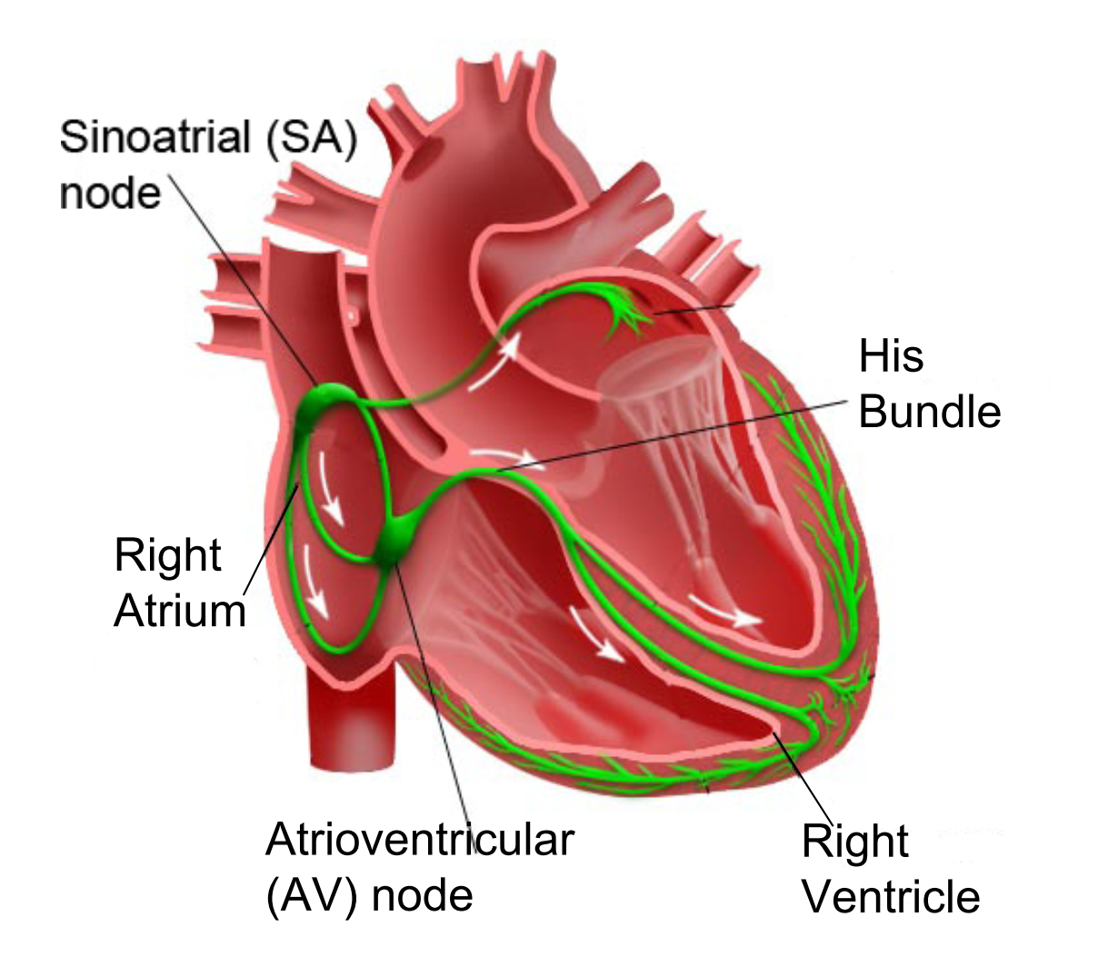
How does a healthy heart work?
SA node (controlled by nervous system) periodically generates an electric pulse
This pulse causes both atria to contract pushing blood into the ventricles
Conduction is delayed at the AV node allowing ventricles to fill
Finally the His-Purkinje system spreads electric activation through ventricles causing them both to contract, pumping blood out of the heart
Electrical Conduction System of the Heart

Slide 30
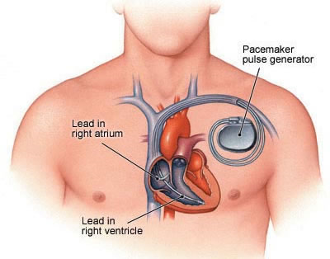
What do pacemakers do?
Aging and/or diseases cause conduction properties of heart tissue to change leading to changes in heart rhythm
Tachycardia: faster than desirable heart rate impairing hemo-dynamics (blood flow dynamics)
Bradycardia: slower heart rate leading to insufficient blood supply
Pacemakers can be used to treat bradycardia by providing pulses when heart rate is low

Slide 31
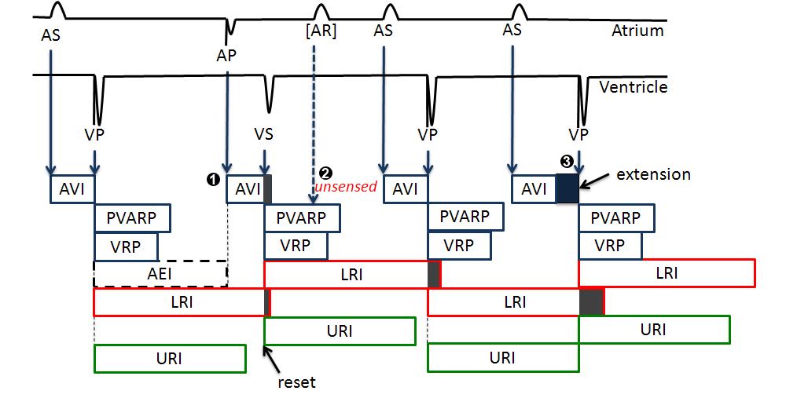
Implantable Pacemaker modeling

Slide 32
How dual-chamber pacemakers work
Two fixed leads on wall of right atrium and ventricle respectively
Activation of local tissue sensed by the leads (giving rise to events Atrial Sense (AS) and Ventricular Sense (VS))
Atrial Pacing (AP) or Ventricular Pacing (VP) are delivered if no sensed events occur within deadlines
Heart
AS
Pacemaker
VS
AP
VP

Slide 33
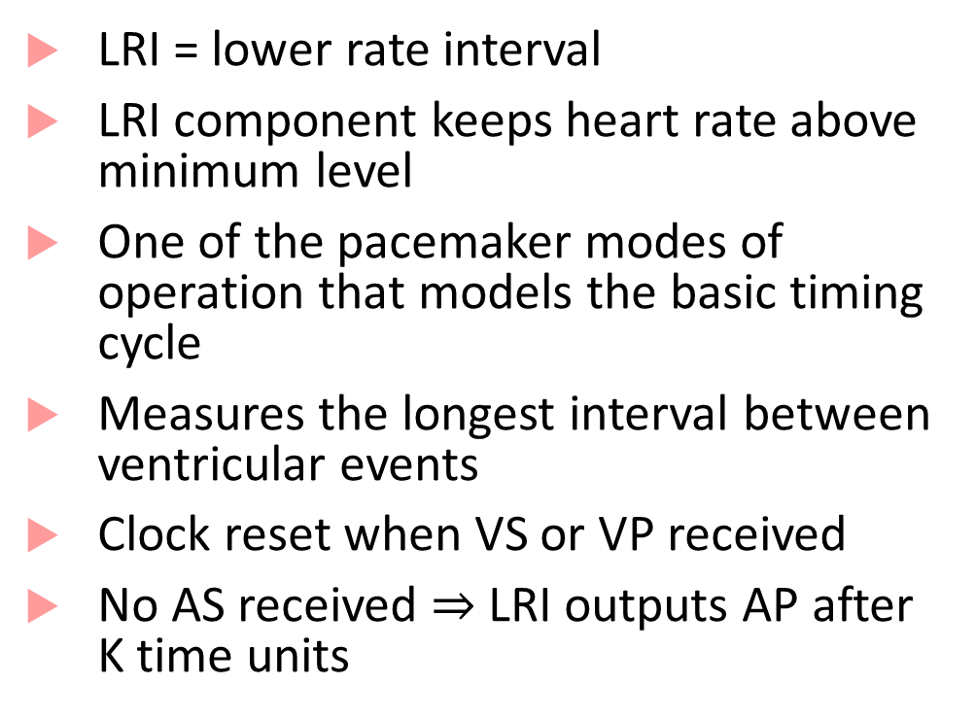






The LRI mode of operation explained
LRI = lower rate interval
LRI component keeps heart rate above minimum level
One of the pacemaker modes of operation that models the basic timing cycle
Measures the longest interval between ventricular events
Clock reset when VS or VP received
No AS received $⇒$LRI outputs AP after K time units
VS? $→$ c:=0
AS?
ASed
VP? $→$ c:=0
LRI
c $≤$ K
VP? $→$ c:=0
VS? $→$ c:=0
c $≥$ K $→$AP!; c:=0
K= 850ms

Slide 34
Continuous-Time Component Definition
Set $I$ of real-valued input variables
Set $O$ or real-valued output variables
Set $X$ of real-valued (continuous) state variables
Initialization $Init$ specifying a set $X_{0}$of initial values for states
Dynamics: for each state variable, $x$, a real valued expression $f$ over $I$ and $X$
Output Function: for each output variable, $y$, a real valued expression $h$ over $I$ and $X$.

Slide 35
Execution Definition
Convention: $x=\left(x_{1},x_{2},…x_{n}\right), y=(y_{1},y_{2},…,y_{m})$
Given an input signal $u:𝕋→ℝ$, an execution consists of a differentiable state signal $x\left(t\right)$, and an output signal $y\left(t\right),$such that:
$x\left(0\right)∈X_{0}$
For each output variable $y$ and time t, $y\left(t\right)=h\left(u\left(t\right), x\left(t\right)\right)$
For each state variable $x$, $\frac{d}{dt}x\left(t\right)=f(u\left(t\right), x\left(t\right))$
$$\dot{x}=f\left(x,u\right)$$
$$y=h(x,u)$$

Slide 36
Existence and Uniqueness of Solutions
Given an input signal $u(t)$, when are we guaranteed that the system has at least one execution? Is there nondeterminism in continuous-time components?
Input signal should be piecewise-continuous, and additional conditions need to be imposed on the RHS of dynamics $(f)$ and output functions $(h)$
Related to solutions for the initial value problem in the classical theory of ODEs
$$\dot{x}=f\left(x,u\right)$$
$$y=h(x,u)$$

Slide 37
Existence
There exists at least one solution $x(t)$ if the function $f$ is continuous
Definition of continuity uses notion of distance between points
Euclidean distance: $d\left(x,y\right)={\left\|x−y\right\|}_{2}= \sqrt{{\left(x_{1}−y_{1}\right)}^{2}+…+{\left(x_{n}−y_{n}\right)}^{2}}$
$f$ is uniformly continuous if for all $ε>0$, there exists a $δ>0$, such that for all $x,y∈ℝ^{n}$, if ${\left\|x−y\right\|}_{2}<δ$, then ${\left\|f\left(x\right)−f\left(y\right)\right\|}_{2}<ε$.
Example when solution does not globally exist:
$\frac{dx}{dt}= \left\{\begin{aligned}1 if x=0 \\ 0 otherwise\end{aligned}\right.$
$$\dot{x}=f\left(x,u\right)$$
$$y=h(x,u)$$

Slide 38

Uniqueness
Solution to initial value problem is unique if $f$ is Lipschitz continuous
Lipschitz-continuity is a stronger version of continuity: upper bounds how fast a function can change
Function $f$ is Lipschitz-continuous if there exists a constant $L$ (called the Lipschitz constant) such that:
$$∀x,y∈ℝ^{n}:\left\|f\left(x\right)−f\left(y\right)\right\|≤L\left\|x−y\right\|$$
Examples:
Linear functions (e.g., $x_{1}−3x_{2}$) are Lipschitz continuous
Functions: $x^{2}$, $\sqrt{x}$ are not Lipschitz continuous over $ℝ^{n}$
Can restrict $𝕋$ and $X$ to some bounded and closed set such that $f$ is piecewise-continuous and Lipschitz to get unique solutions over such compact domains
$$\dot{x}=f\left(x,u\right)$$
$$y=h(x,u)$$

Slide 39
What do numeric solvers/simulators do?
Allow modeling arbitrarily complex functions: even functions with unbounded discontinuities
May not be even possible to check for Lipschitz conditions for what’s implemented
Rely on numerical integration schemes/solvers to obtain solutions
ode45, ode23, ode15, etc.

Slide 40

Linear Systems
Equation of simple car dynamics can be written compactly as:
$\left[\begin{matrix}\dot{x} \\ \dot{v}\end{matrix}\right]=\left[\begin{matrix}0 & 1 \\ 0 & −k/m\end{matrix}\right]\left[\begin{matrix}x \\ v\end{matrix}\right]+\left[\begin{matrix}0 \\ 1/m\end{matrix}\right][F]$
Letting $A=\left[\begin{matrix}0 & 1 \\ 0 & −k/m\end{matrix}\right], B=\left[\begin{matrix}0 \\ 1\end{matrix}\right]$, we can re-write above equation in the form:
$\dot{x}=Ax+Bu$, where $x=\left[\begin{matrix}x & v\end{matrix}\right]$, and $u=\left[F\right]$

Slide 41

Linear Dynamical Systems
Special kind of dynamical system
$$\dot{x}=f\left(x,u\right)$$
$$y=h(x,u)$$
$f$ is of the form $a_{1}x_{1}+…+a_{n}x_{n}$ + $b_{1}u_{1}+…+b_{m}u_{m}$ or compactly, $f=Ax+Bu$
$h$ is of the form $c_{1}x_{1}+…+c_{n}x_{n}$ + $d_{1}u_{1}+…+d_{m}u_{m}$ or compactly, $h=Cx+Du$
Linear algebra was invented to reason about linear systems!
Linear systems have many nice properties:
Many analysis methods in the frequency domain (using Fourier/Laplace transform methods)
Superposition principle (net response to two or more stimuli is the sum of responses to each stimulus)

Slide 42

Solutions to Linear Systems
Autonomous linear system has no inputs: $\dot{x}=Ax$
Solution of autonomous linear system can be fully characterized:
$x\left(t\right)=e^{At}x_{0}$
$e^{A}$ is a matrix exponential = $I+A+\frac{A^{2}}{2!}+\frac{A^{3}}{3!}+\frac{A^{4}}{4!}+ …$
$e^{A}$ is usually approximated to the first $k$ terms
Computing $e^{A}$ is easy if $A$is a diagonal matrix (non-zero elements are only on the diagonal)
In practice, numerical integration methods outperform matrix exponential
For a linear system with exogenous inputs?
$x\left(t\right)=e^{At}x_{0}+\int_{0}^{t}{e^{A\left(t−τ\right)}Bu\left(τ\right)dτ}$

Slide 43
Stability of Systems
Property capturing the ability of a system to return to a quiescent state after perturbation
Stable systems recover after disturbances, unstable systems may not
Almost always a desirable property for a system design
Fundamental problem in control: design controllers to stabilize a system
Problem: Cart-pole is inherently unstable, aim: keep it upright
Solution Strategy: Move cart in direction in the same direction as the pendulum’s falling direction
Design problem: Design a controller to stabilize the system by computing velocity and direction for cart travel

Slide 44

Lyapunov stability
$$x^{∗}$$
$$x(0)$$
System $\dot{x}=f\left(x\right)$
Equilibrium point when $f\left(x\right)$ is zero (say $x^{∗})$
Equilibrium point $x^{∗}$ is Lyapunov-stable if:
For every $ε>0$,
There exists a $δ>0$, such that
if $\left\|x\left(0\right)−x^{∗}\right\|<δ,$ then,
for every $t≥0,$ we have $\left\|x\left(t\right)−x^{∗}\right\|<ε$
$ε$-ball
$δ$-ball

Slide 45
Asymptotic + Exponential Stability
System $\dot{x}=f\left(x\right)$
Equilibrium point $x^{∗}$ is asymptotically-stable if:
$x^{∗}$ is Lyapunov-stable +
There exists $δ>0$ s.t. if $\left\|x\left(0\right)−x^{∗}\right\|<δ$, then $\lim_{t→∞}{‖x\left(t\right)−x^{∗}‖}=0$
Equilibrium point $x^{∗}$ is exponentially-stable if:
$x^{∗}$is asymptotically stable +
There exist $α>0,β>0$ s.t. if $\left\|x\left(0\right)−x^{∗}\right\|<δ$, then for all $t≥0:$
$$\left\|x\left(t\right)−x^{∗}\right\|≤α\left\|x\left(0\right)−x^{∗}\right\|e^{−βt}$$

Slide 46
What do these definitions all mean?
Lyapunov stable: solutions starting $δ$close from equilibrium point must remain close (within $ε)$ forever
Asymptotically stable: solutions not only remain close, but also converge to the equilibrium
Exponentially stable: solutions not only converge to the equilibrium, but in fact converge at least as fast as a known exponential rate
All stable linear systems are exponentially stable
This need not be true for nonlinear systems!

Slide 47

Analyzing stability for linear systems
Eigenvalues of a matrix $A$:
Value $λ$ satisfying the equation $Av=λv$. $v$ is called the eigenvector
Equivalent to saying: values satisfying $\left|A−λI\right|=0$, where $I$ is the identity matrix
Interesting result for linear systems: System $\dot{x}=Ax$ is asymptotically stable if and only if every eigenvalue of $A$ has a negative real part
Lyapunov stable if and only if every eigenvalue has non-positive real part
Nonlinear systems: no simple analysis technique exists
Next time we will look at Lyapunov’s methods, which allow reasoning about stability of nonlinear systems

Slide 48
Finite State Automata: A 3-slide introduction

Slide 49









Finite state automata
Famous equivalence between finite state automata and regular expressions
$$A_{1}$$
$$A_{2}$$
$$q_{0}$$
$$q_{f}$$
$$q_{0}$$
$$q_{f}$$
a-z
a-z
a-z,0-9
0-9
a-z
$$q_{1}$$
$$q_{1}$$
$$q_{r}$$
State
0-9
[a-z][a-z 0-9 ]
*
Accepting
state
[a-z][0-9]*[a-z]

Slide 50






How does a finite state automaton work?
Starts at the initial state $q_{0}$
In $q_{0}$, if it receives a letter in a-z, goes to $q_{1}$
else, it goes to $q_{r}$
In $q_{1}$, if it receives a number in 0-9, it stays in $q_{1}$
else, it goes to $q_{f}$ (as it received a-z)
In $q_{r}$, no matter what it gets, it stays in $q_{r}$
$q_{f}$ is an accepting state where computation halts
Any string that takes the machine from $q_{0}$ to $q_{f}$ is accepted by the machine
$$A_{2}$$
$$q_{0}$$
$$q_{f}$$
a-z
0-9
a-z
$$q_{1}$$
$$q_{r}$$
0-9
*

Slide 51

Language of a finite state automaton
What strings are accepted by $A_{2}$?
ab, zy, s2r, q123s, u3123123v, etc.
What strings are not accepted by $A_{2}$?
2b, 334a, etc.
The set of all strings accepted by $A_{2}$ is called its language
The language of a finite state automaton consists of strings, each of which can be arbitrarily long, but finite
$$A_{2}$$
$$q_{0}$$
$$q_{f}$$
a-z
0-9
a-z
$$q_{1}$$
$$q_{r}$$
0-9
*

Slide 52
Timed Automata
Useful tool to do timing analysis and explore properties of timed processes
State-space of timed automata is infinite (clocks can become arbitrarily large!)
But some questions about timed automata behavior can still be answered exactly
Does the automaton accept any string? (also known as emptiness problem)
Reachability of a particular configuration
We will revisit this later in the course

Slide 53


Timing Analysis
D
(y >= 6)?
Which of D, E, F can be reached?
Needs careful propagation of reachable combinations of x and y
x,y:=0
A
x<=5
x>=3 → y:=0
B
x<=7
(y >= 2)?
C
x$≤$8
y $≤$5
(x <= 4)?
E
(x = 7)?
x $∈\left[3,5\right]$, y $=0$ when we reach B
x $∈\left[3,7\right],$ y $∈[2,∞)$ when we reach C
x $∈[3,8]$, y $∈$ $[2,5]$ when you exit C
OR x $∈\left[3,8\right],$ y $≥5$ and machine stops
F

Slide 54
How is such analysis done?
The key challenge is that if the automata has loops, then how do we know that our procedure for propagation of symbolic clock constraints will terminate?
The key insight by first papers on timed automata was that there is only a finite number of regions in the clock-space that can be visited
This gives a “pumping lemma” style argument*
Allows abstracting a finite timed automaton to an automaton where modes/states represent the regions
This was expensive, and improved by using zone-based constructions
(zones are a uniform representation of constraints that arise during analysis)

